Slide 1
Luxury Bag Price Analysis and Prediction by ML
Bootcamp Final Project
By Yan

Slide 2

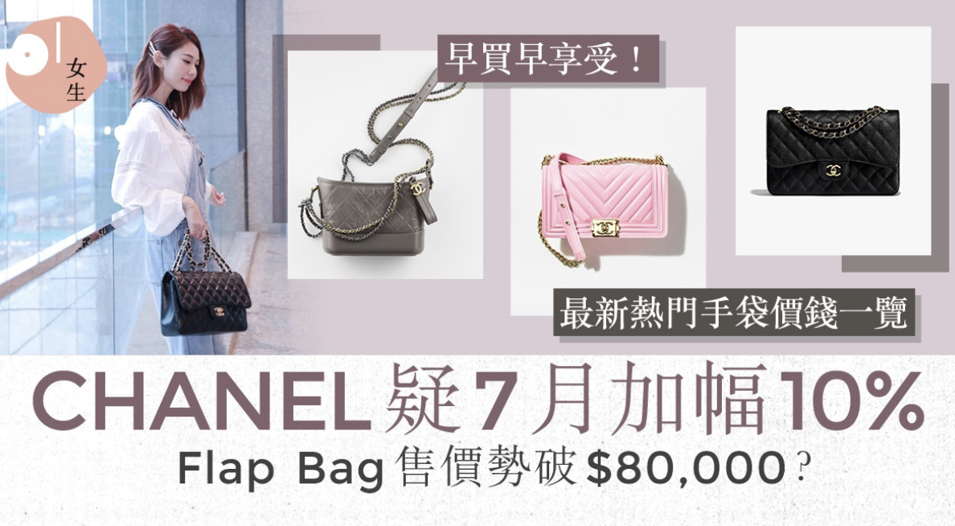
Background
Luxury Bag is keep price up year by year

Slide 3
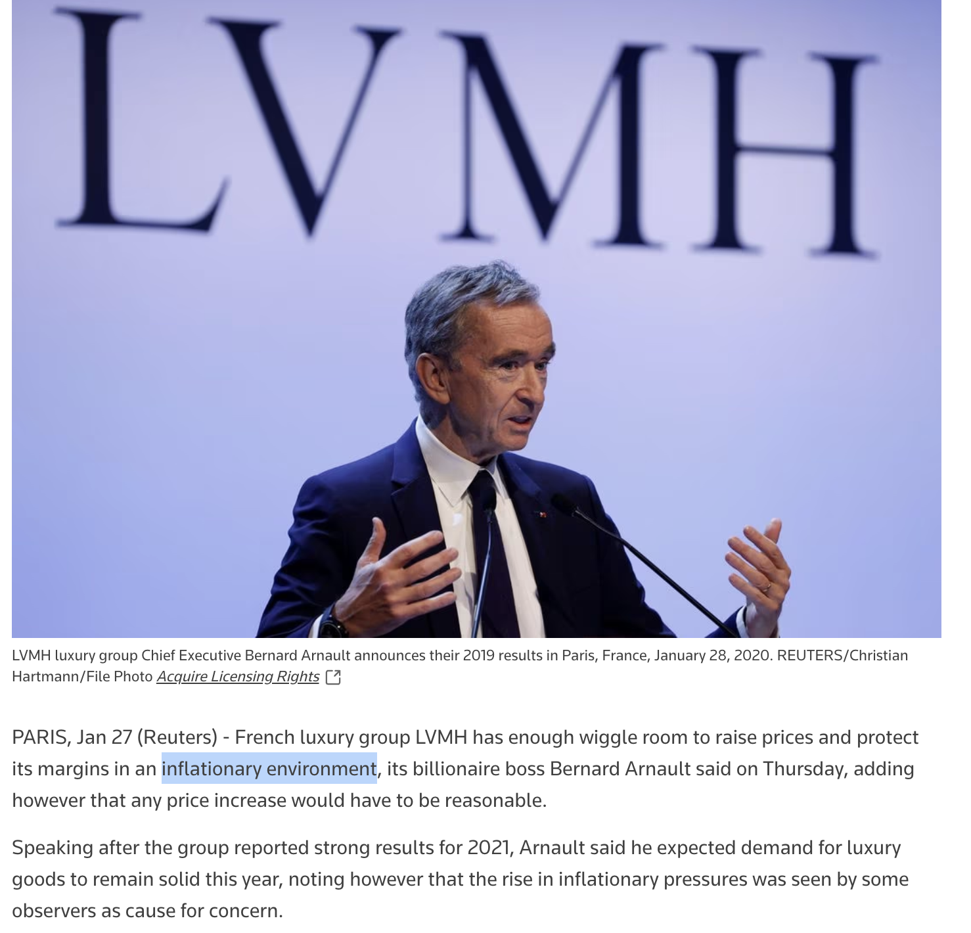
Background
LVMH claim raise prices is to protect its margins in an inflationary environment
It increases the production and operation cost

Slide 4
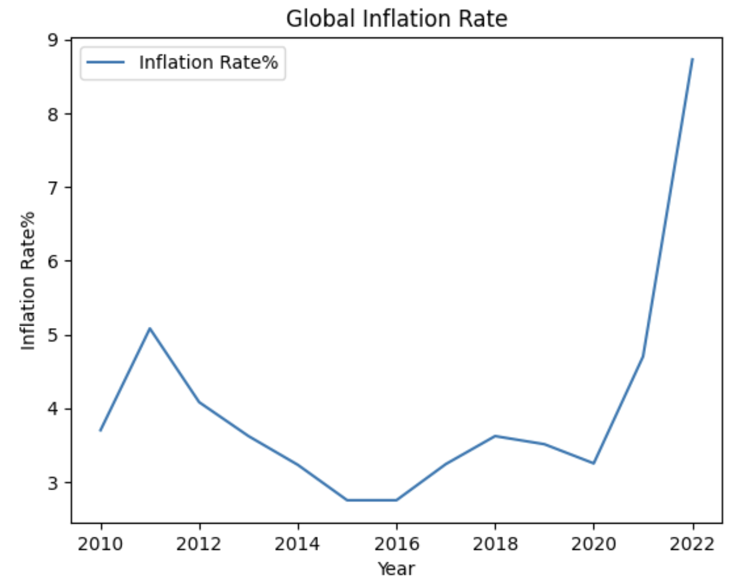
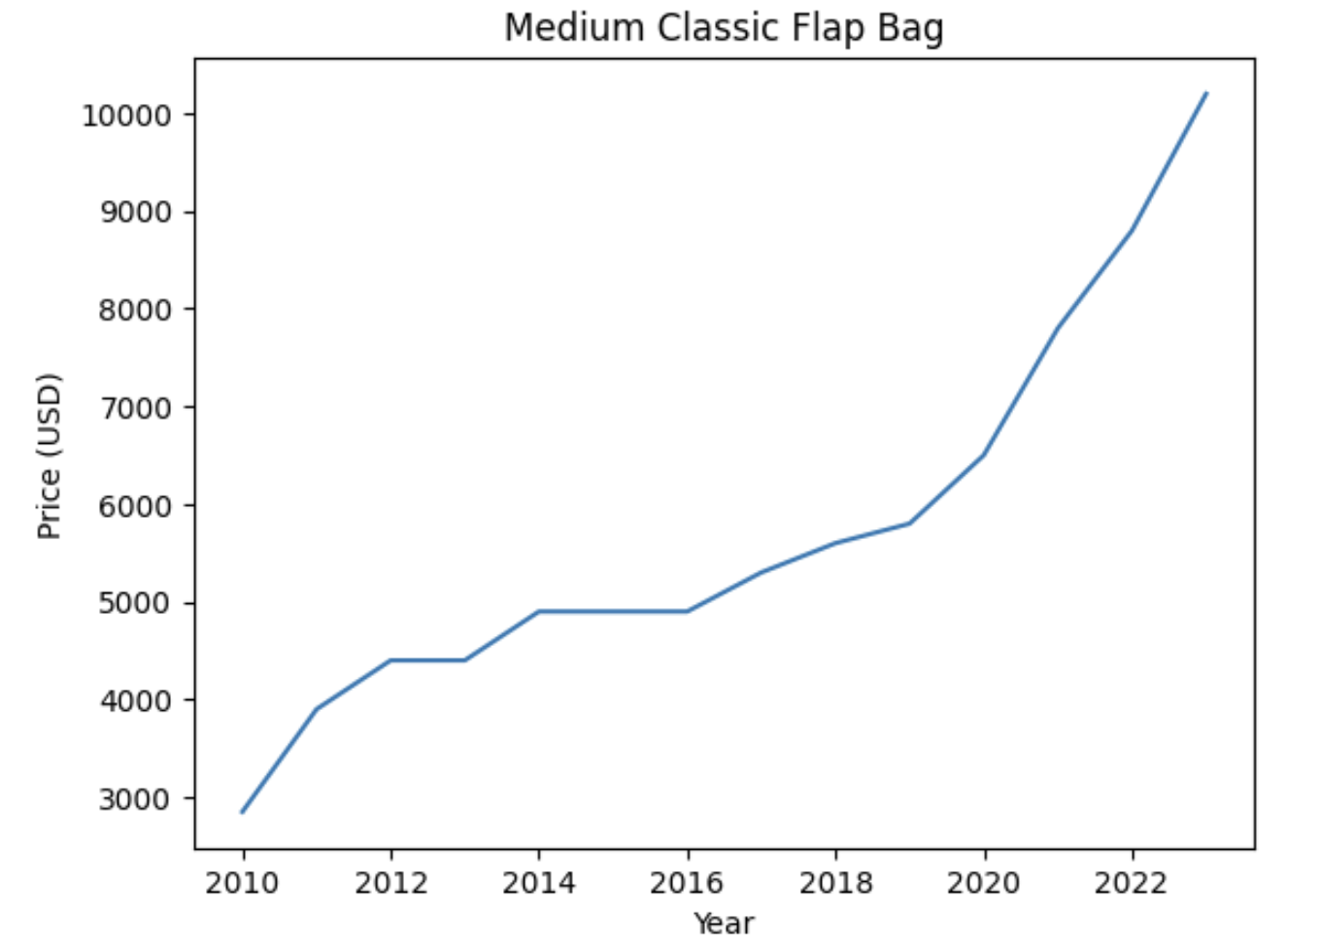
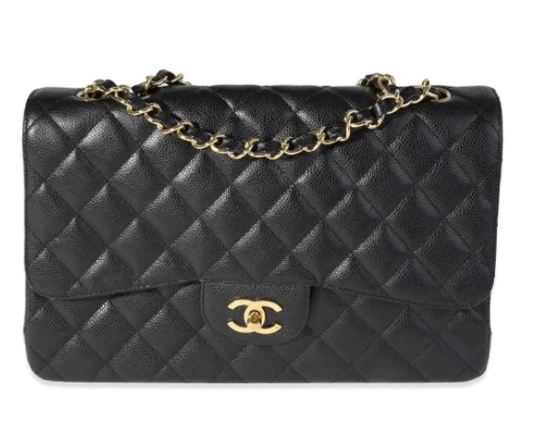
Background
Inflation rate and Chanel bag selling price are not in close relationship

Slide 5
Objective
Analyzes the factors driving the pricing trend
Forecast of future price movements

Slide 6
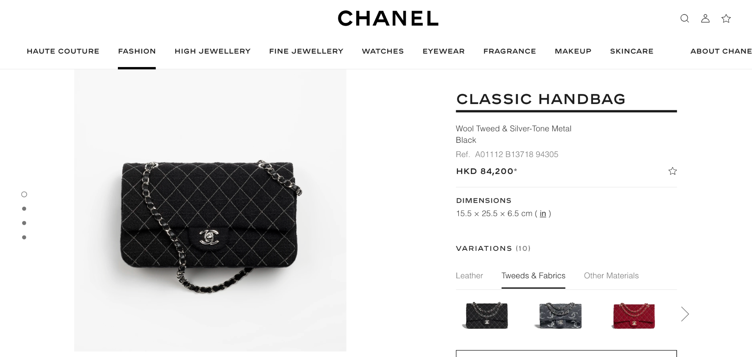
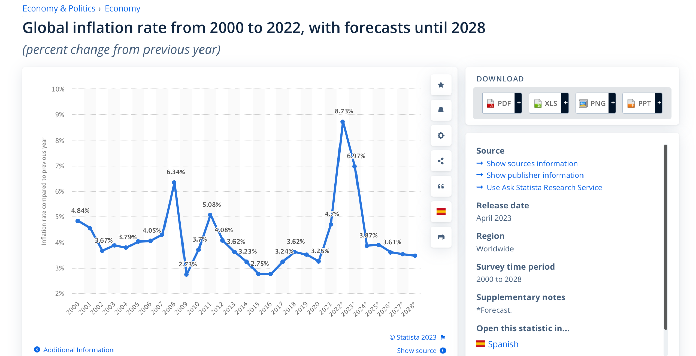
Data Collection - Source & Method
Economic Data
Download from Organisation
Data Platform (e.g.Statista)
Selling Price for Luxury Bag
Official Website (Web Scraping)
News and fashion article (Web Scraping )

Slide 7
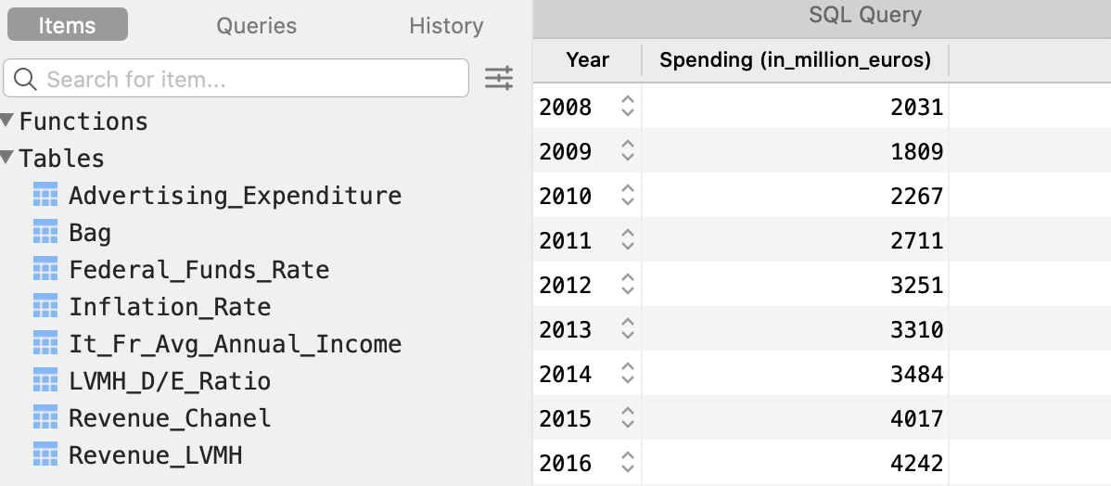
Data Storage
Database - MySQL
User Friendly UI Design
Easy to merge and filter data
Connect to IDE

Slide 8
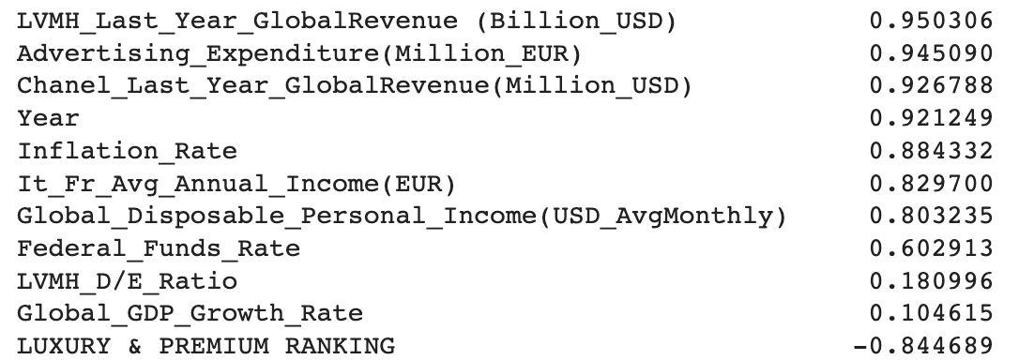
Data Analysis - Factors driving the pricing trend
Find out each features by calculating correlation with Price

Slide 9
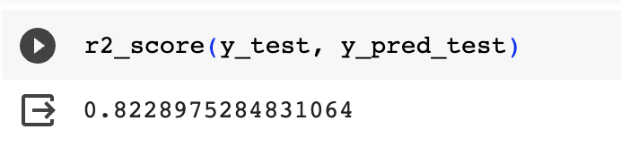
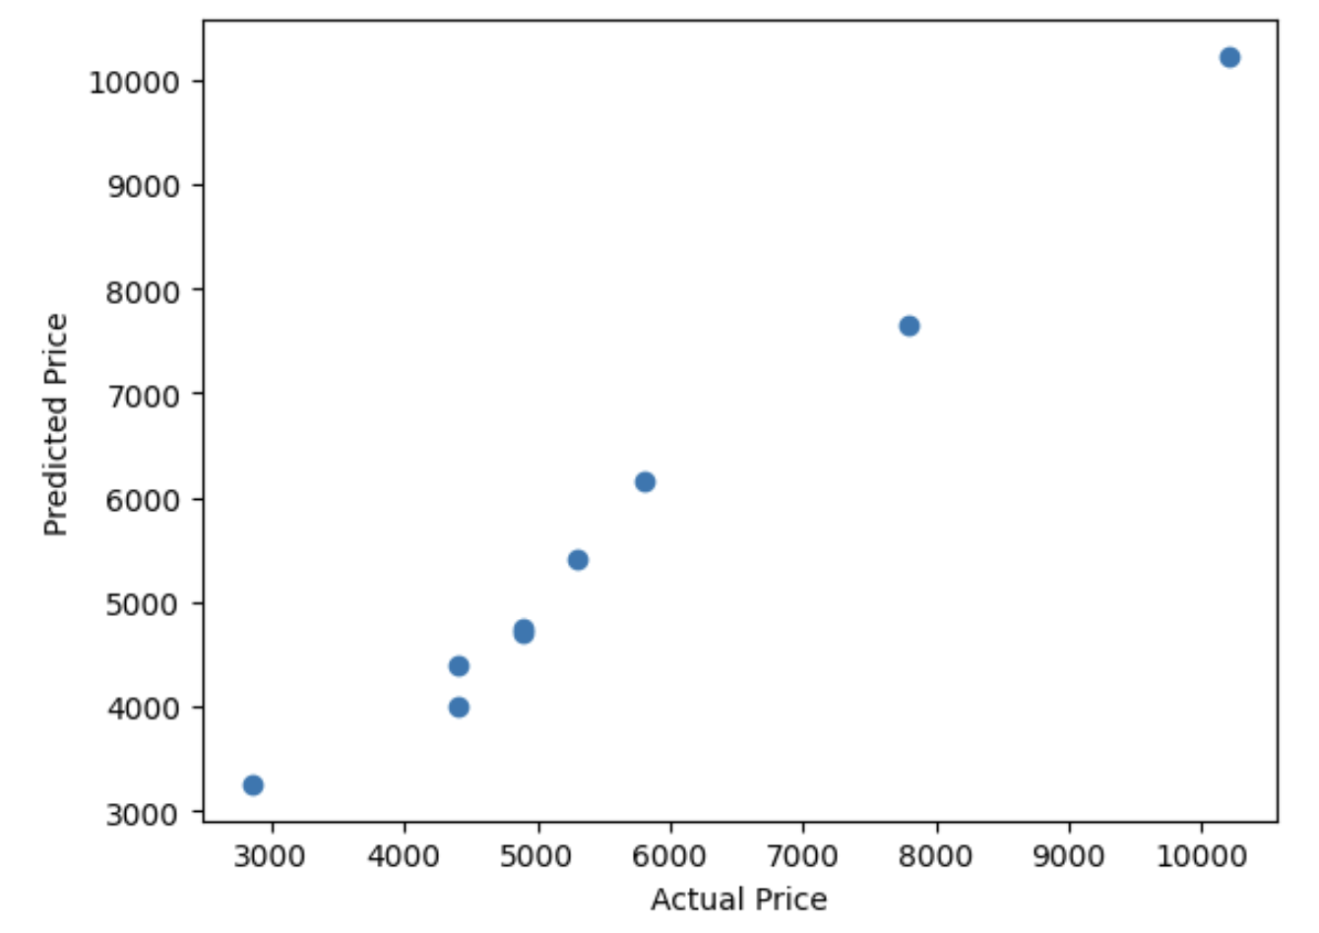
Data Analysis
Multiple Linear Regression - By Sklearn
Label : Price of Chanel Medium Classic Flap Bag

Slide 10
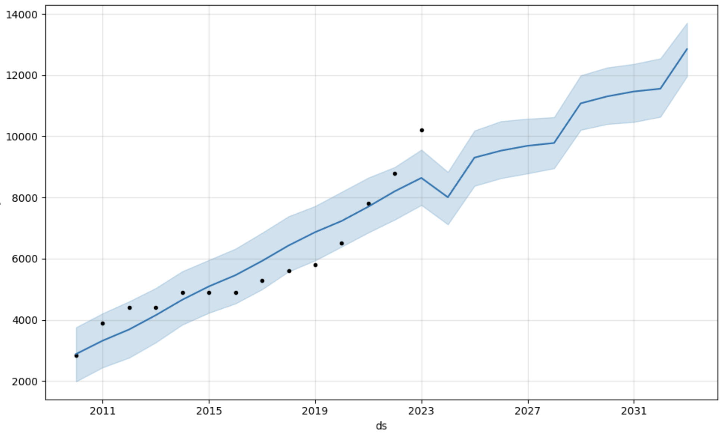
Data Analysis
Time Series - Prophet

Slide 11
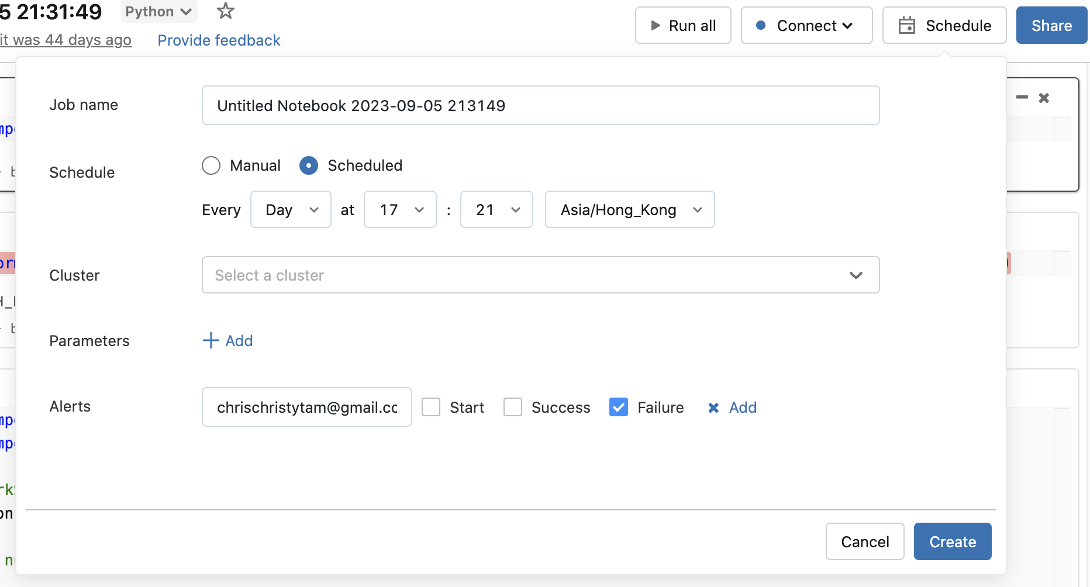
Scheduling
Schedule as daily task to track any update in price

Slide 12
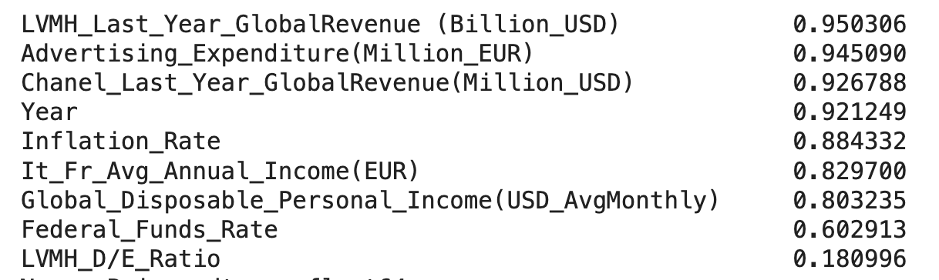
Data Analysis - Outcome
To find out the main reason determine Luxury Bag pricing
LVMH Financial Performance

Slide 13
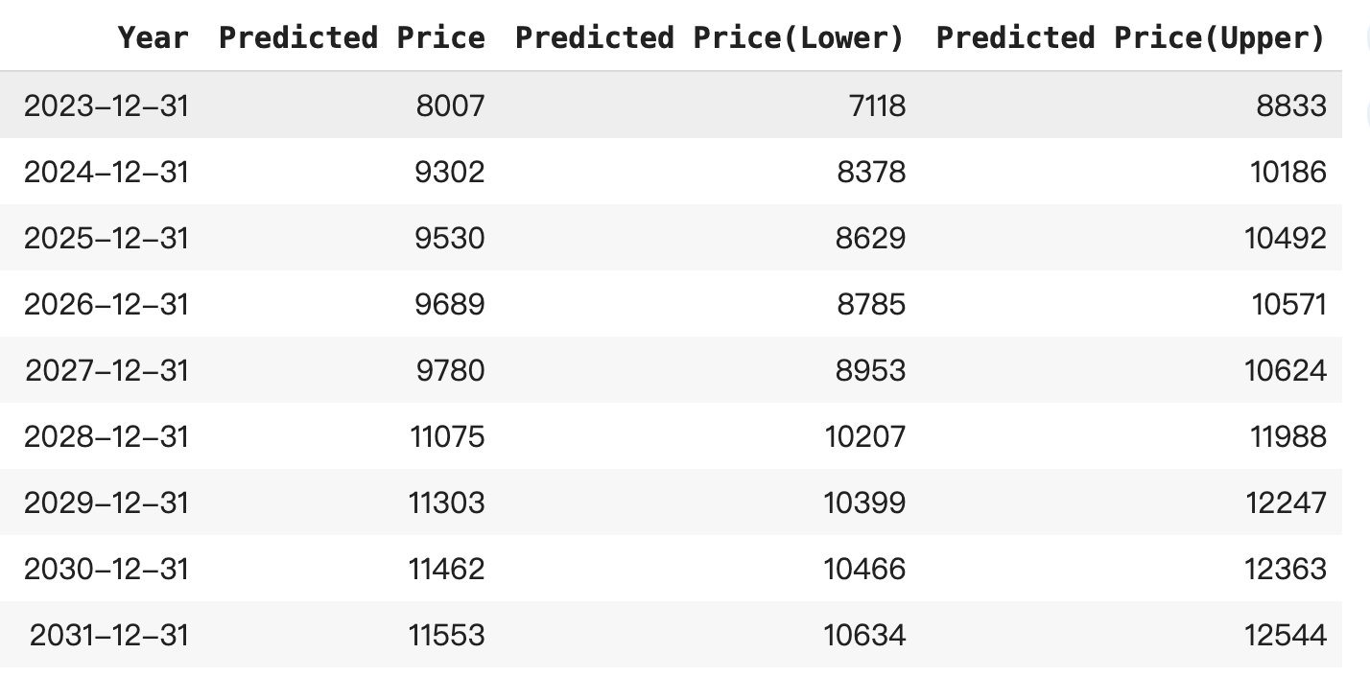
Data Analysis - Outcome
2. Predict Luxury Bag selling price

Slide 14
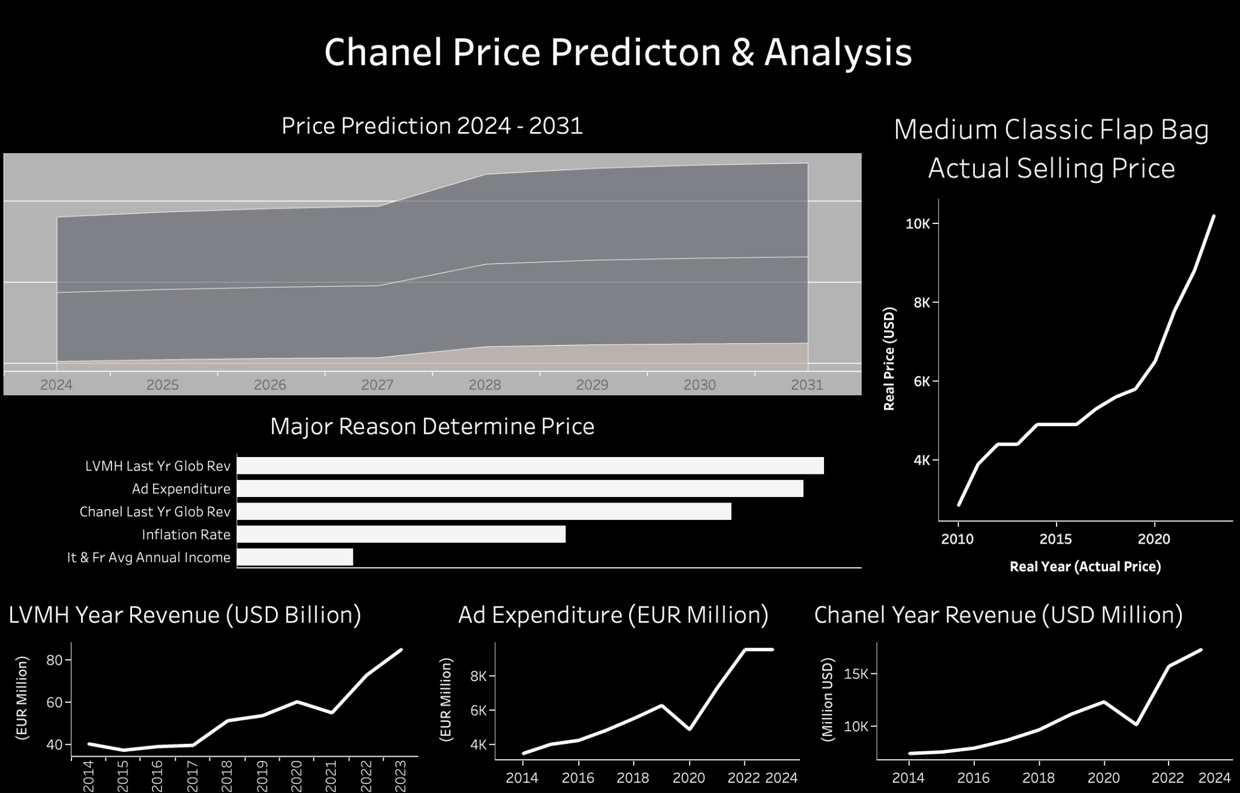
Data Visualization

